Slide 1


PERFORMANCE COMPARISON OF HYBRID ENCRYPTION MODELS
ARCHITECTING INTELLIGENT SYSTEMS PROJECT
BY :
ASWIN PALATHUMVEETTIL JAGADEESAN
I2COST PROGRAM
UNIVERSITY OF L’AQUILA

Slide 2
INTRODUCTION
Cryptographic systems secure sensitive data through advanced encryption techniques.
The 5 pillars of cryptography: Confidentiality, Integrity, Authentication, Authorization, and Non-repudiation.
Cryptography algorithms are mathematical procedures designed to transform plaintext into ciphertext(encryption) and vice versa(decryption).
Symmetric Encryption: Uses a single key for both encryption and decryption.
Asymmetric Encryption: Utilizes a pair of keys - public key for encryption and private key for decryption.
This project aims to conduct a comprehensive analysis and comparison of hybrid cryptographic systems using following algorithms
AES , Blowfish, RSA, ECC
Notes:
Crypto algo ensure- Confidentiality, Integrity, Authentication, Authorization, and Non-repudiation auth - verifying the identity of a user non-repudiation - originator of a message cannot deny having sent the message

Slide 3
SYMMETRIC ENCRYPTION ALGORITHMS - BLOWFISH
Symmetric block cipher, Feistel Network which involves 16 iterations, with variable key lengths up to 448 bits and has a block size of 64 bits.
Key Expansion and Data Encryption: The algorithm involves key expansion to generate subkeys and performs data encryption through a 16-round Feistel network using permutation and substitution operations.
Figure 1 and 2 explain how algorithm operates
Notes:
Applications: Blowfish finds applications in bulk encryption, random bit generation, packet encryption, and hashing. structure used in block ciphers, where the input block is divided into two halves that undergo multiple rounds of processing

Slide 4
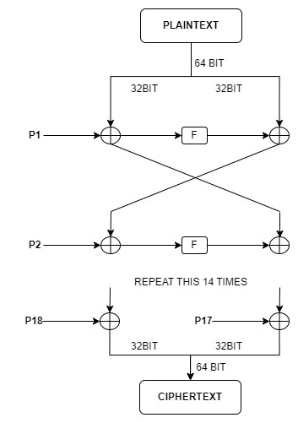
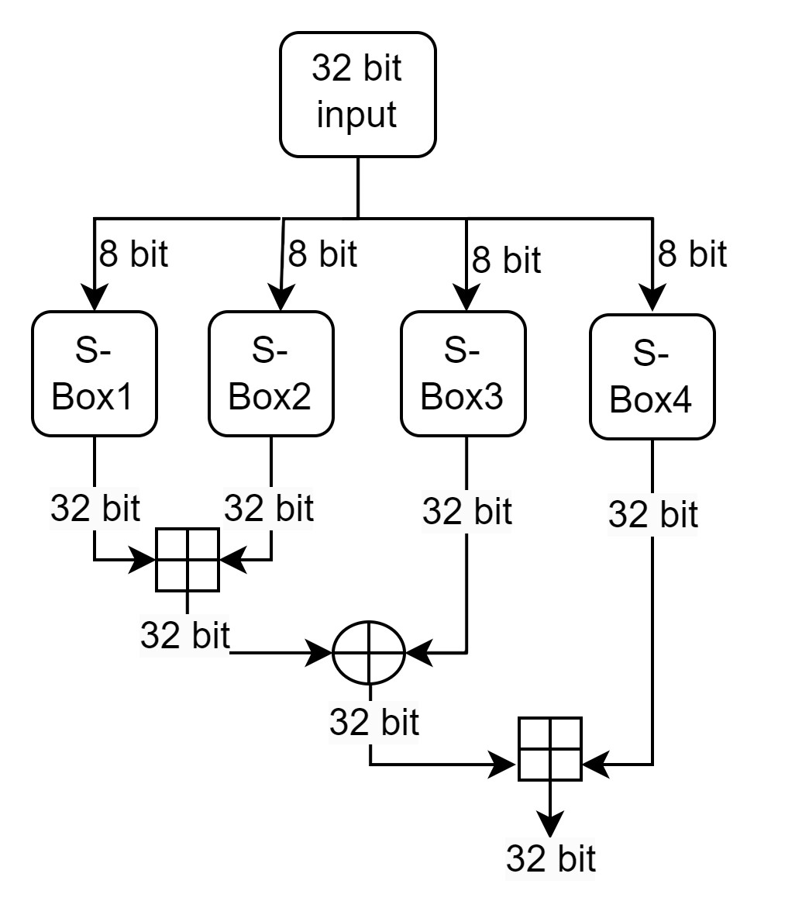
Figure 1
Figure 2

Slide 5
SYMMETRIC ENCRYPTION ALGORITHMS - ADVANCED ENCRYPTION STANDARD
AES (Advanced Encryption Standard) is a widely used symmetric encryption algorithm, introduced as Rijndael by two Belgian cryptographers.
Block Size and Key Length: AES operates on blocks of 128 bits and supports key lengths of 128, 192, and 256 bits.
Number of Rounds: The number of encryption/decryption rounds in AES depends on the key size, with 10 rounds for a 128-bit key, 12 rounds for a 192-bit key, and 14 rounds for a 256-bit key.
Encryption Process: AES encryption involves several layers, including key addition, byte substitution, ShiftRows, and MixColumn, which provide confusion and diffusion properties to the data.

Slide 6
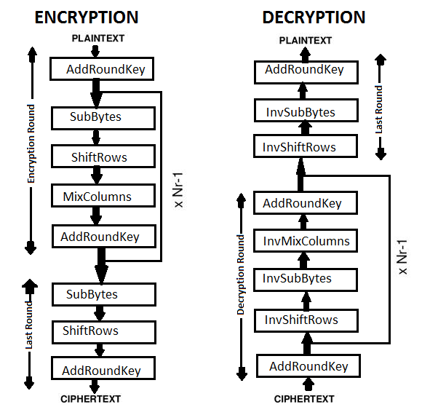

Slide 7
ASYMMETRIC ENCRYPTION ALGORITHMS- RSA
Public key cryptosystem invented by Rivest, Shamir, and Adleman
RSA relies on the difficulty of factorizing a large composite number into its prime factors.
Modulus and Phi(n): RSA involves selecting two large prime numbers, computing their product as the modulus (n), and calculating phi(n) by multiplying (p-1) and (q-1).
Public and Private Keys: RSA uses a public key (n, e) for encryption and a private key (d) for decryption. The public exponent (e) is chosen to be co-prime with phi(n), and the private key (d) is calculated accordingly.
y = ekpub(x) = (x^e)(modn) (1)
x = dkpr(y) = (y^d)(modn) (2)
Encryption and Decryption: RSA encryption is performed using a specific formula (1), while decryption utilizes another formula (2) to retrieve the original plaintext from the ciphertext. In equations, x is plaintext and y is ciphertext

Slide 8
ASYMMETRIC ENCRYPTION ALGORITHMS- ECC
Encryption system that utilizes elliptic curves for public key cryptography.
ECDH is a cryptographic algorithm that enables two parties to establish a shared secret over an unsecured channel. It utilizes elliptic curves to provide secure key agreement based on the exchange of public-private key pairs.
Generator Point : It is used for scalar multiplication to generate all other points on the curve, enabling optimized and secure cryptography protocols
Shared Key Generation : Sender and receiver generate private keys, exchange public keys, and compute a shared key for symmetric encryption/decryption.
(senderprivatekey)∗(receiverpublickey) = a∗(b∗G)
(receiverprivatekey)∗(senderpublickey) = b∗(a∗G)

Slide 9
HASHING
Hashing: Hashing is a process that converts data of any size into a fixed-length value or key. The output is known as a hash value or message digest. MD5, SHA-1, and SHA-256 are examples.
Uses of Hashing: data integrity checking, password storage, and digital signatures.
SHA-256: SHA-256 is a widely used cryptographic hashing algorithm, generating a fixed-length output of 256 bits. It belongs to the robust SHA-2 family of algorithms and is widely supported across different systems and applications.

Slide 10
PROJECT PROPOSAL
Implementing four combinations of asymmetric and symmetric algorithms (RSA-AES, ECC-AES, RSA-Blowfish, and ECC-Blowfish) hybrid encryption models to compare their performance.
The hash of the ciphertext is sent along with the ciphertext itself to the receiver for message integrity verification.
The asymmetric algorithm is used for secure key exchange, while the symmetric algorithm is used for message encryption.
AES and Blowfish with key size 128 bit and RSA with key size 1024 bit is implemented

Slide 11
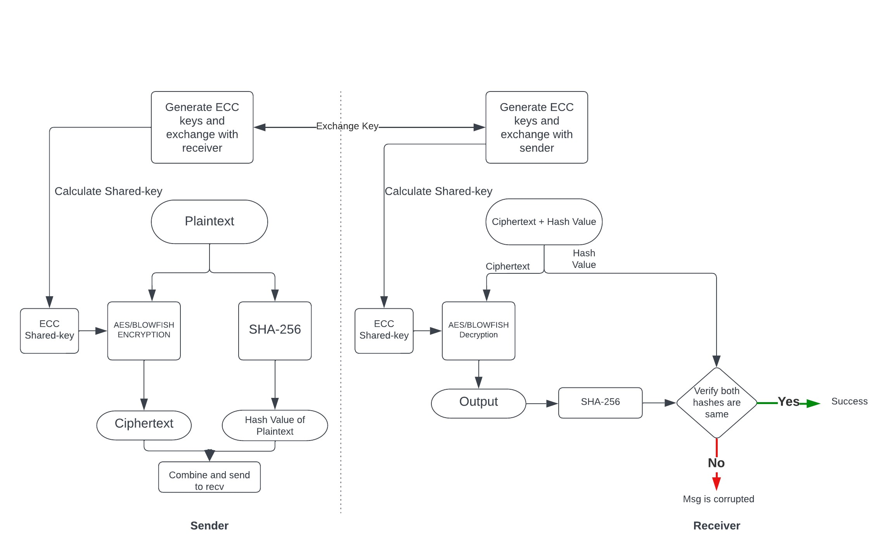

Slide 12
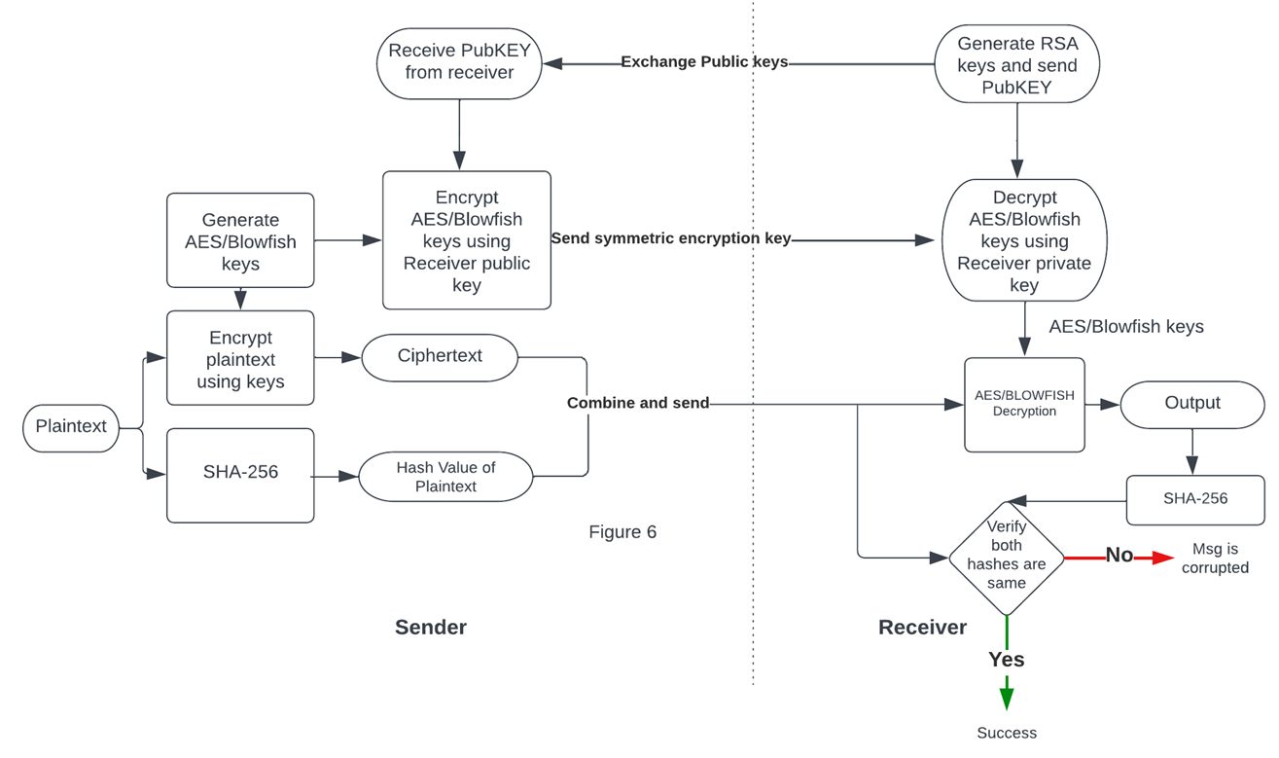

Slide 13
COMPARISON FACTORS: PERFORMANCE AND RANDOMNESS CHARACTERISTICS
Time, CPU usage, and Memory usage during encryption and decryption.
Hamming distance: Measures the difference between two equal-length strings by counting the differing positions.
Avalanche effect: Small input changes cause large output changes.
Throughput: Rate at which a cryptographic system can encrypt or decrypt data.
Correlation coefficient: Measure the strength of the relationship between two sets of data

Slide 14
RESULTS
Algorithms implemented using Python libraries.
Text files of different sizes (1kb, 2kb, 5kb, 10kb, and 20kb) generated using an online tool.
Each model was executed 30 times for each file size, and average values were calculated from the outputs.
Performance evaluation includes processing time, CPU usage, and memory usage
Randomness of the cipher assessed through Avalanche effect and correlation coefficient measurements.

Slide 15
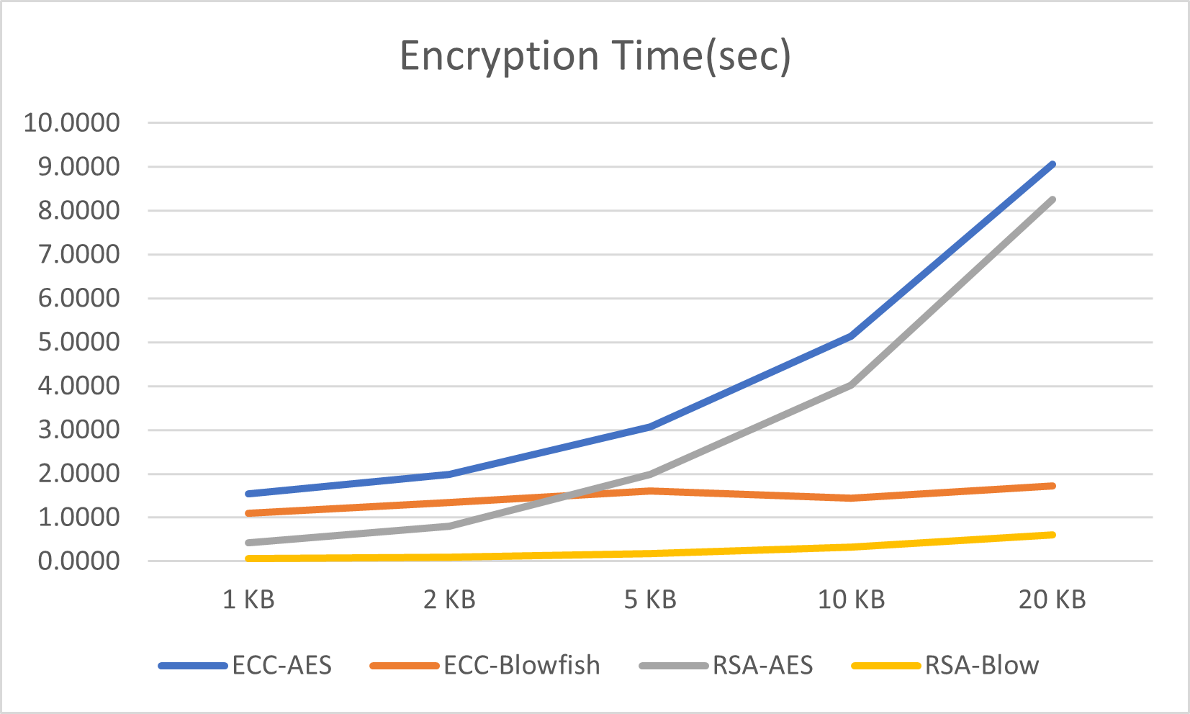
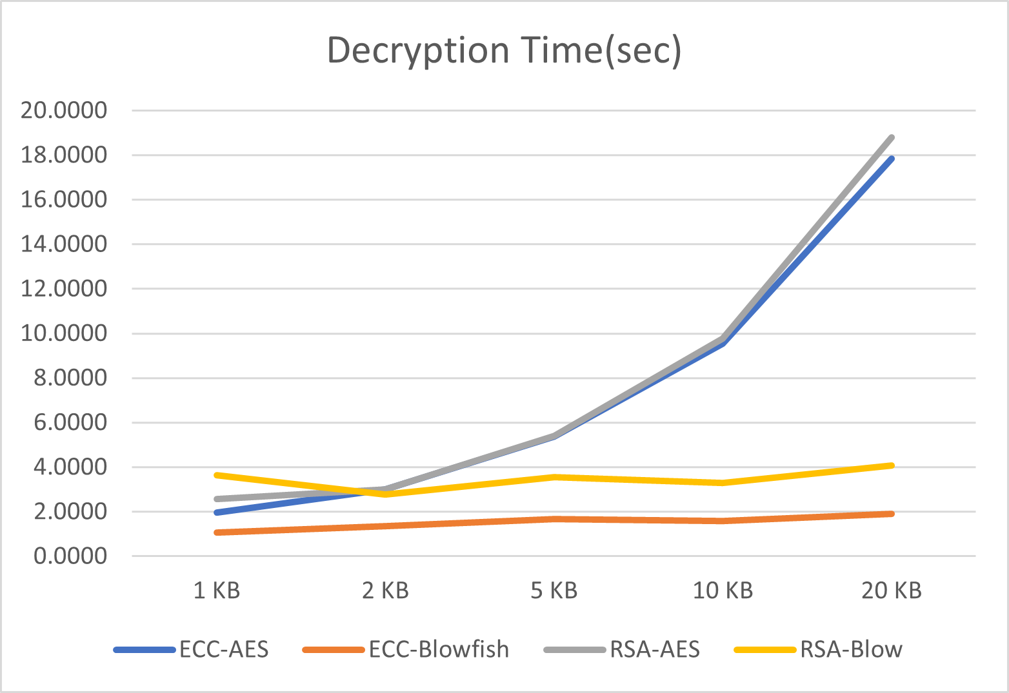
RESULTS – TIME USAGE

Slide 16
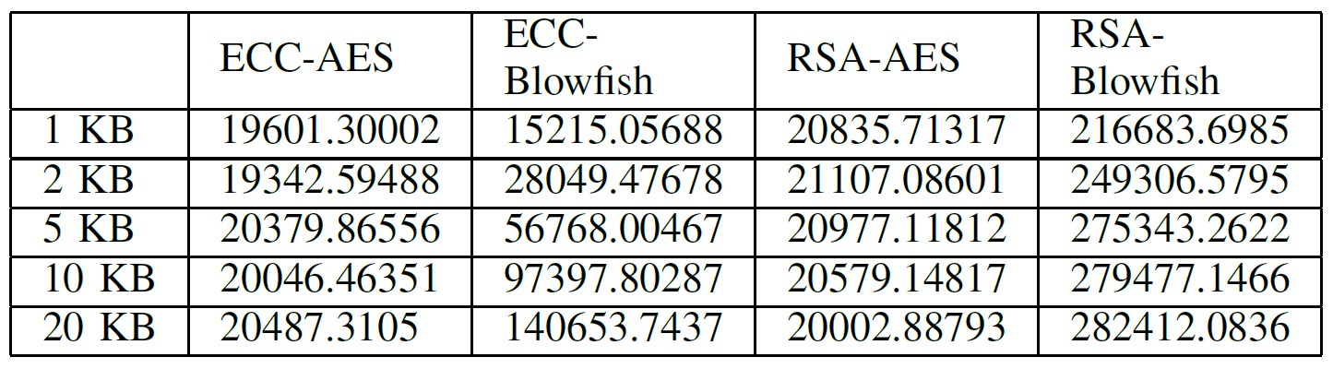
RESULTS -THROUGHPUT

Slide 17
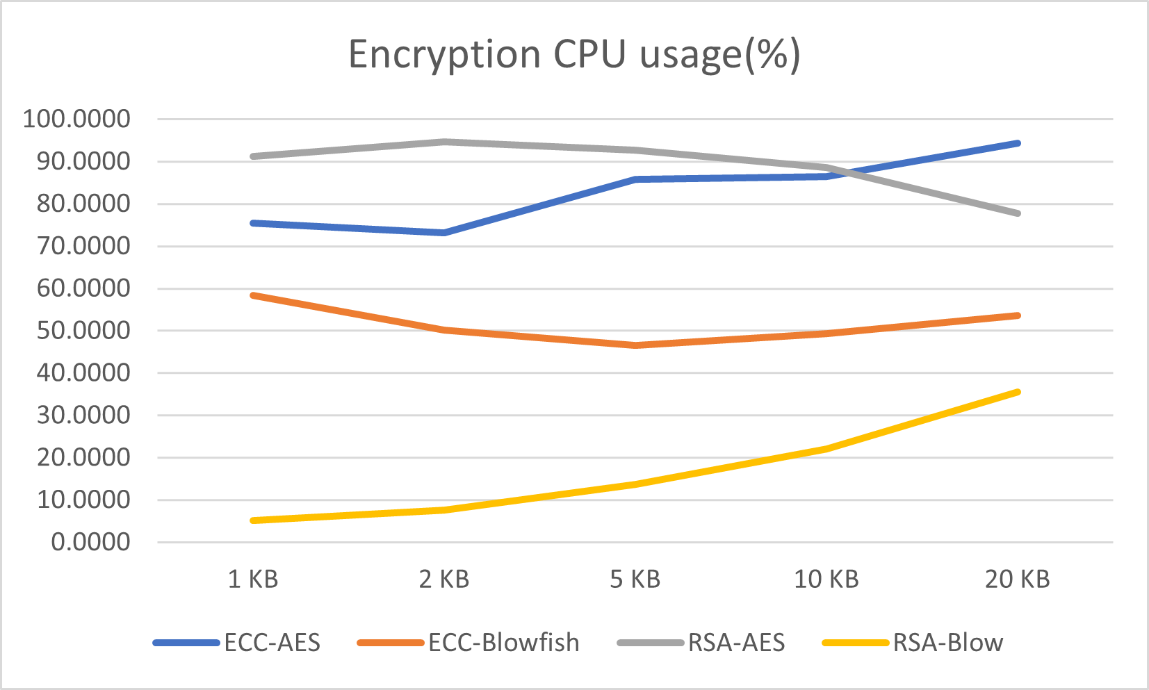
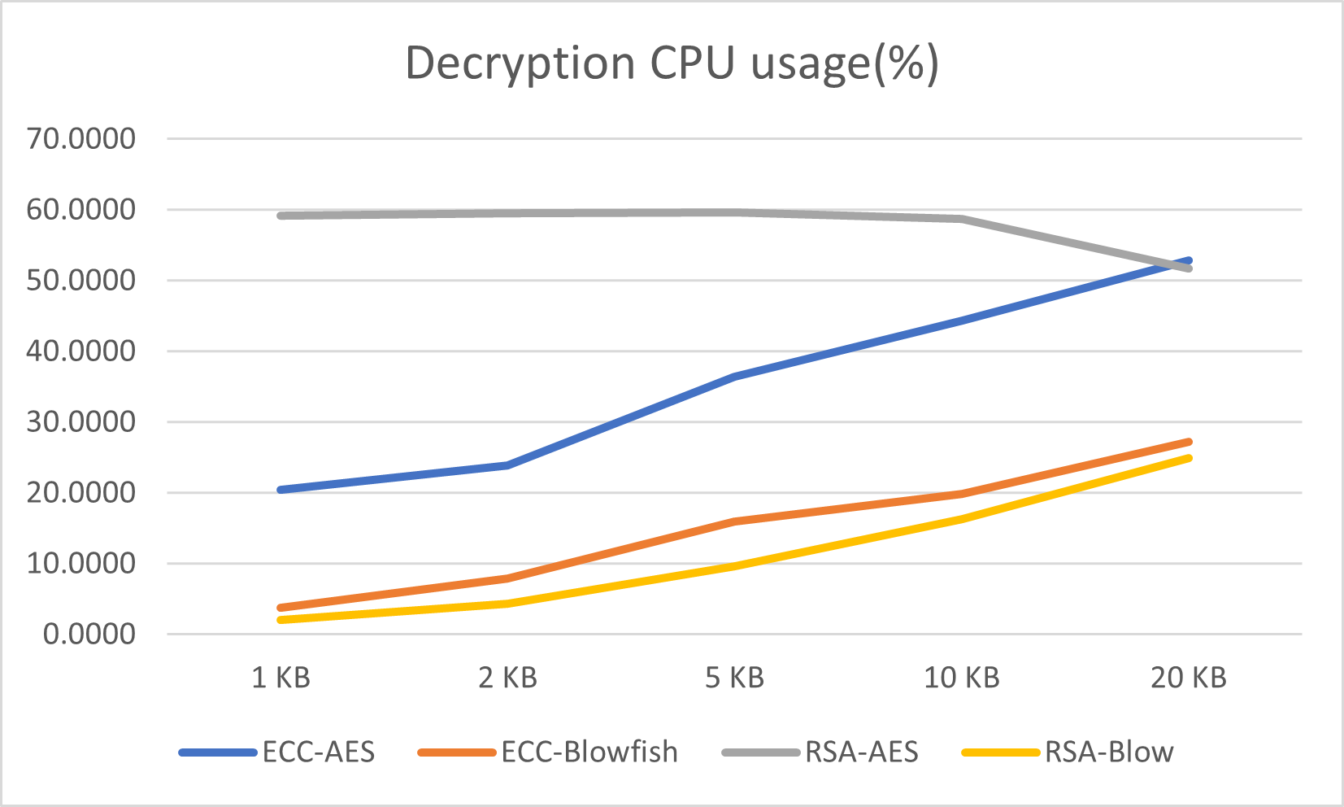
RESULTS – CPU USAGE

Slide 18
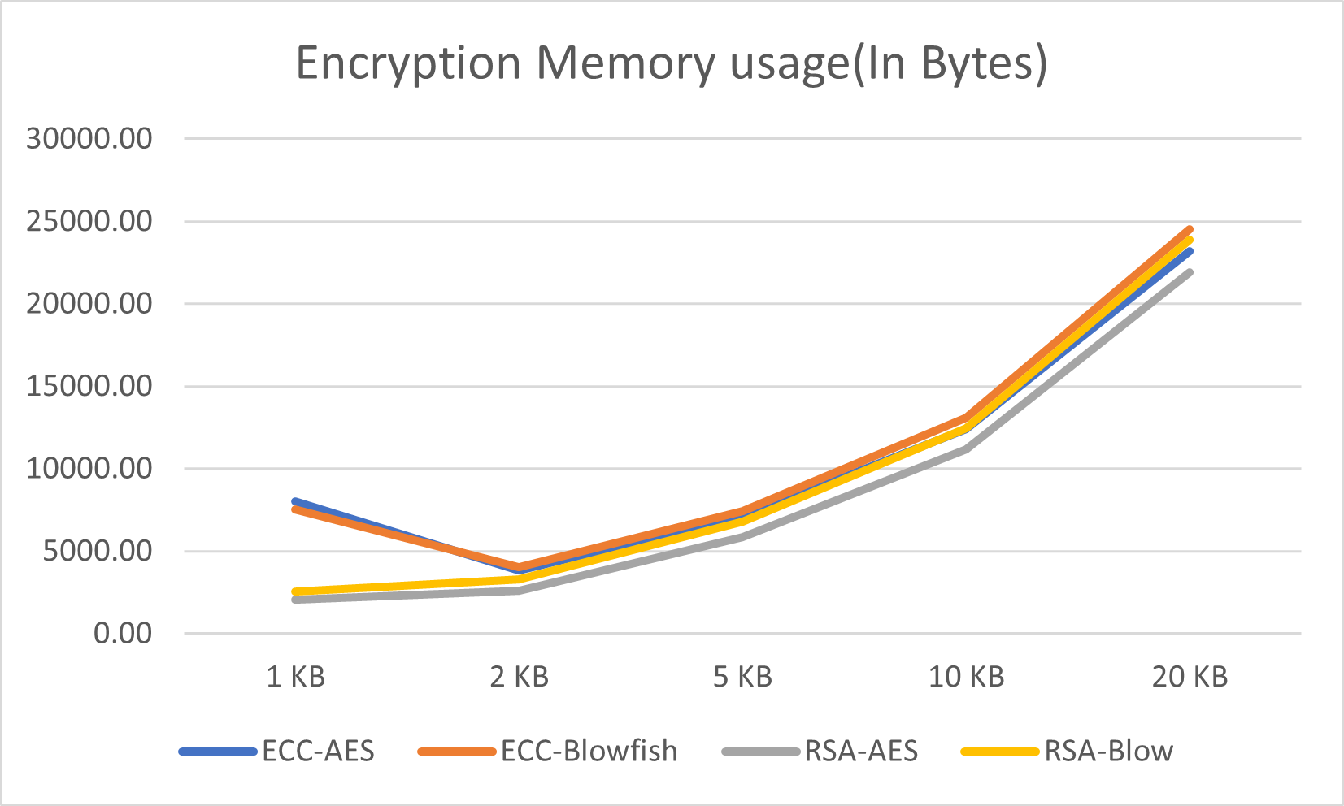
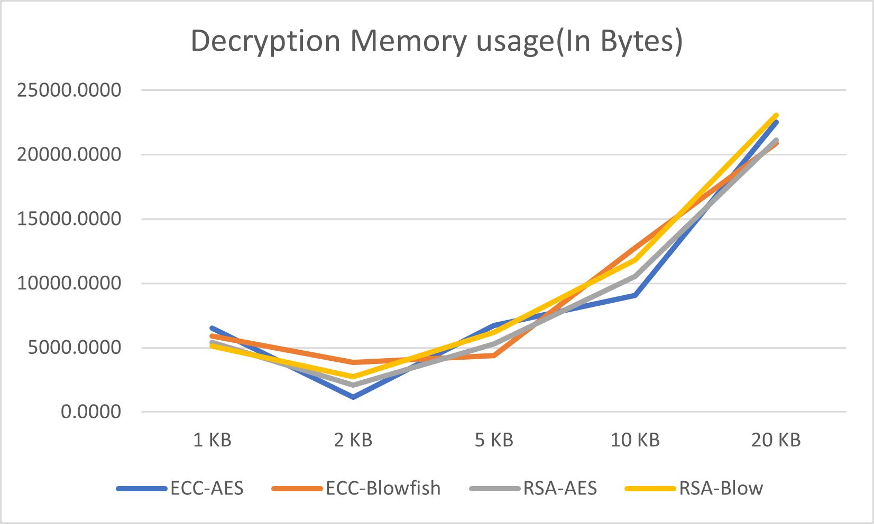
RESULTS – MEMORY USAGE

Slide 19
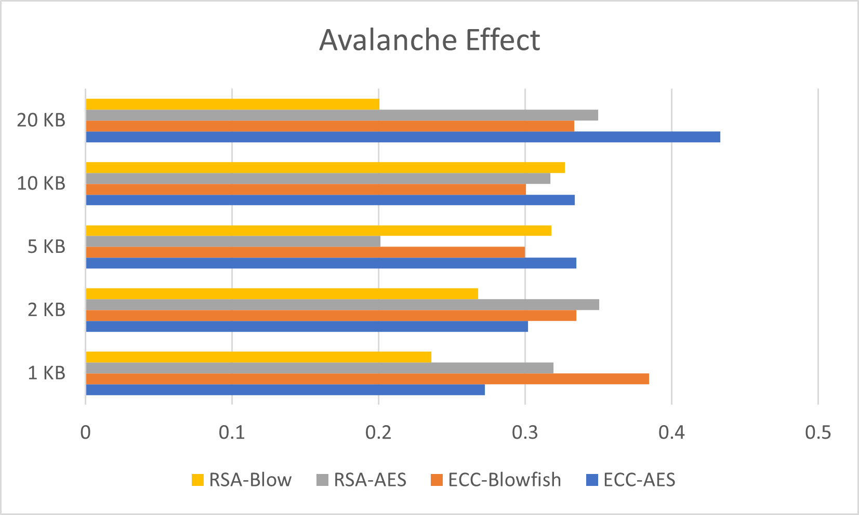
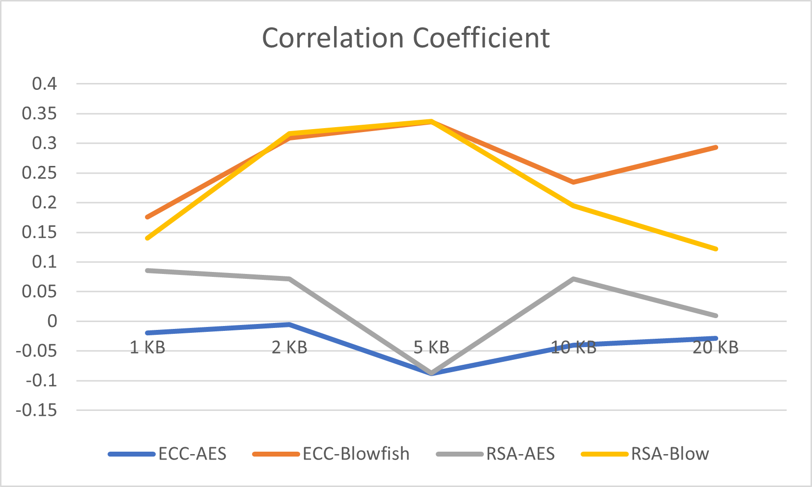
RESULTS – RANDOMNESS TEST

Slide 20
CONCLUSION & FUTURE WORK
The Blowfish algorithm performs better in terms of overall performance, while the AES models exhibit stronger randomness characteristics.
The RSA-Blowfish model exhibits superior performance, while the ECC-AES model shows a slight advantage in terms of randomness factors.
Encryption algorithm selection depends on security requirements, performance requirements, and available resources.
Optimization of the ECC implementation
Future work can explore encryption methods for different types of files
Future work can include implementing other randomness test for each algorithms.

Slide 21
RELATED WORK
N. AbdElnapi, F. A. Omara, and N. F. Omran, “A hybrid hashing security algorithm for data storage on cloud computing,” International Journal of Computer Science and Information Security (IJCSIS), vol. 14, no. 4,2016.
D. P. Timothy and A. K. Santra, “A hybrid cryptography algorithm for cloud computing security,” in 2017 international conference on microelectronic devices, circuits and systems (ICMDCS). IEEE, 2017,pp. 1–5.
V. Kapoor and R. Yadav, “A hybrid cryptography technique for improving network security,” International Journal of Computer Applications, vol. 141, no. 11, pp. 25–30, 2016.
D. S. AbdElminaam, “Improving the security of cloud computing by building new hybrid cryptography algorithms,” International Journal of Electronics and Information Engineering, vol. 8, no. 1, pp. 40–48, 2018.
G. P. Kanna and V. Vasudevan, “Enhancing the security of user data using the keyword encryption and hybrid cryptographic algorithm in cloud,” in 2016 International Conference on Electrical, Electronics, and Optimization Techniques (ICEEOT). IEEE, 2016, pp. 3688–3693.
Notes:
AES RSA with SHA256
blowfish RSA with SHA256
RSA, DES and SHA1 and it is implemented using JAVA
4) AES and Blowfish and state that it is faster and more secure encryption
5) RSA and ECC

Slide 22

Q &A

